Slide 1
A&P 242 Unit 4
Lecture 5

Slide 2
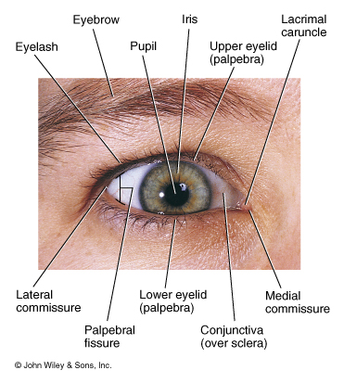
External Anatomy of the Eye

Slide 3
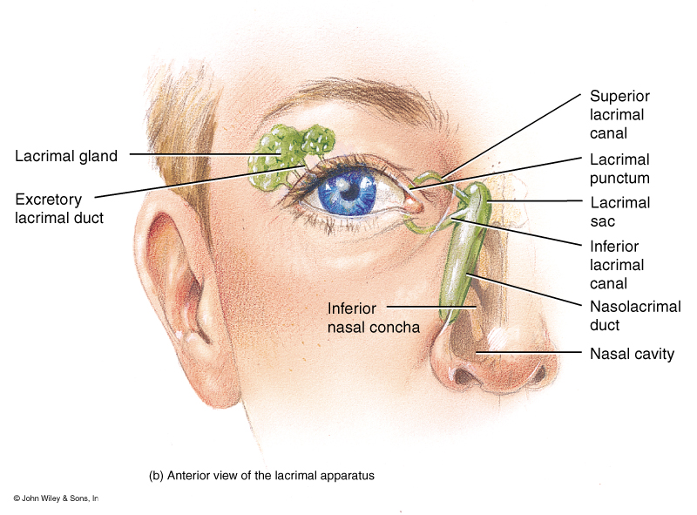
Lacrimal Apparatus of the Eye

Slide 4
Anatomy of the Eyeball
Fibrous Tunic:
Cornea
Sclera
Vascular Tunic
Choroid coat
Ciliary Body (Ciliary muscle, Ciliary process)
Iris
Nervous Tunic
Retina

Slide 5
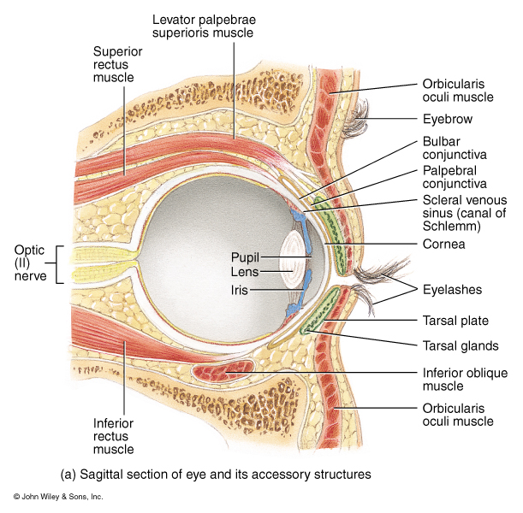
Accessory structures of the Eye from a sagittal view

Slide 6
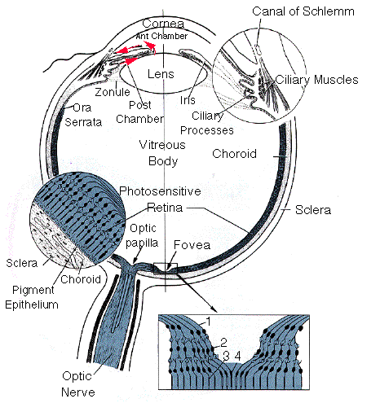
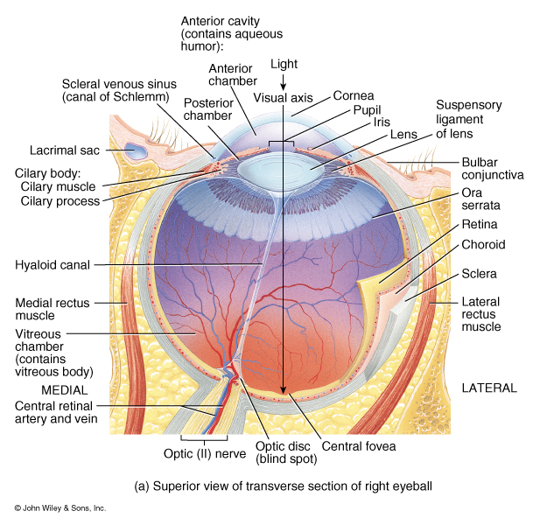
Internal Anatomy of the Eye

Slide 7
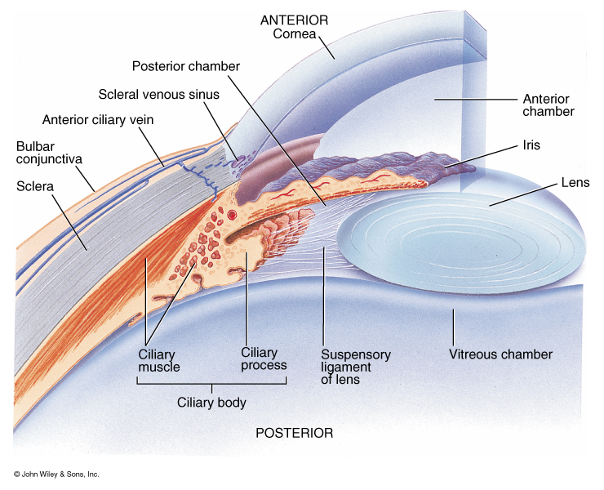
Detail view of the anterior anatomy of the eye

Slide 8
Production of Aqueous Humor and Intraocular pressure
Ciliary Process:
Produces Aqueous Humor
2. Posterior Chamber:
Aqueous Humor flows from
this chamber through the
pupil in Anterior Chamber
Canal of Schlemm
Reabsorbs Aqueous Humor
Glaucoma:
Increase in intraocular
pressure due to build up of
Aqueous Humor

Slide 9
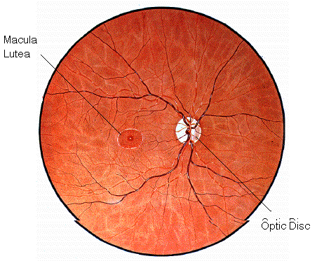
Opthalmoscopic view of the retina showing the location of the Macula to the Optic Disc

Slide 10
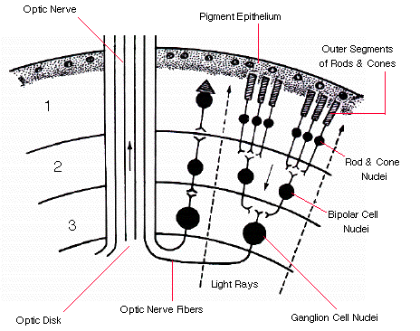
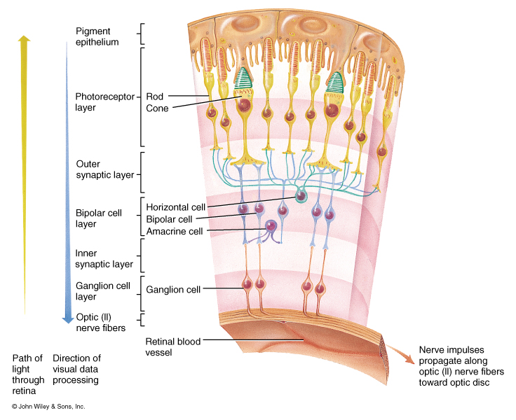
Histology of the retina of the eye

Slide 11
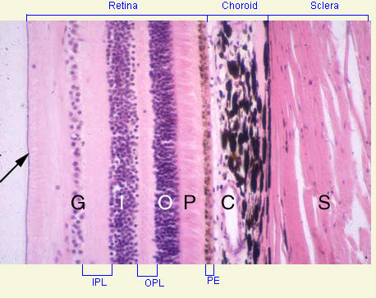
Photomicroscopic view of the Histology of the Eye
S = Sclera
C = Choroid coat
PE = Pigmented
epithelium
P = Outer segments
of rods and cones
O = Nuclei of rods and
cones
OPL = Outer synaptic layer
I = Nuclei of bipolar neurons
PL = Inner synaptic layer
G = Ganglion cell layer

Slide 12
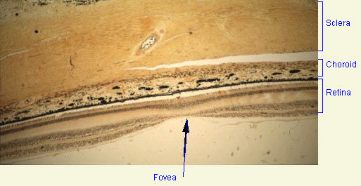
Photomicroscopic view of the Histology of the Eye
showing the location of the central fovea

Slide 13
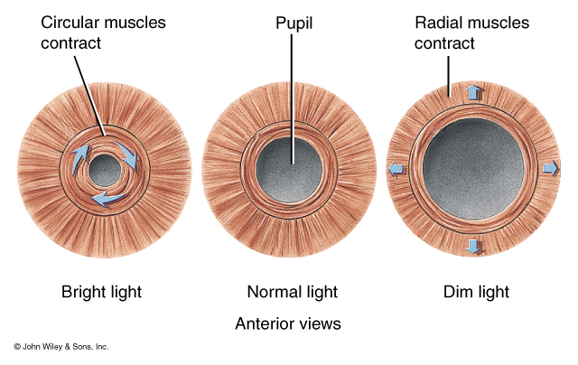
Intrinsic Eye Muscles and their response to light

Slide 14
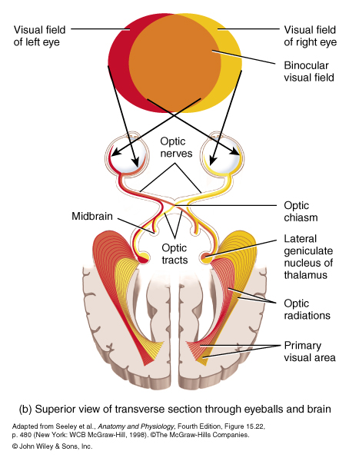
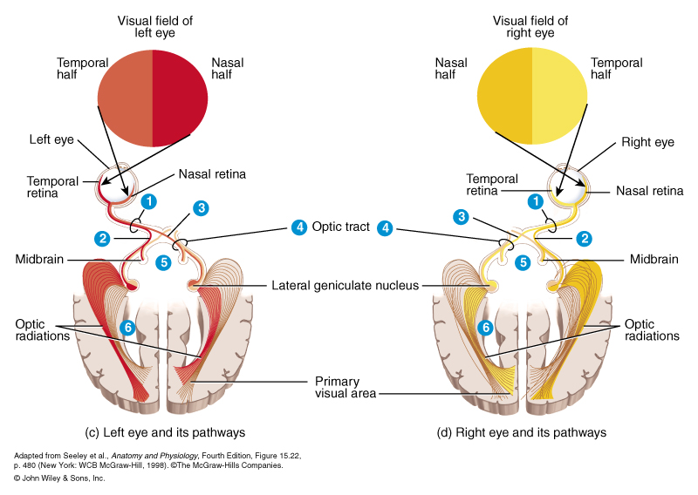
The Visual Pathway

Slide 15
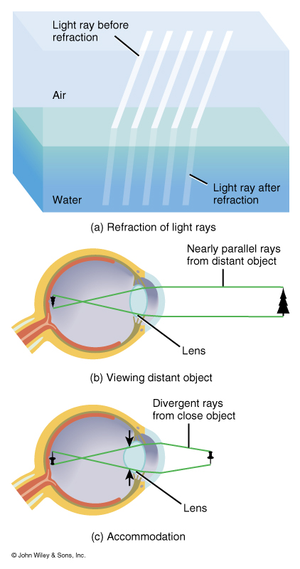
Light Refractory
Pathway:
Bulbar Conjunctiva
Cornea
Aqueous Humor
Lens
Vitreous Humor
Ganglion Cell Layer
Inner Synaptic Layer
Bipolar Layer
Outer Synaptic Layer
Photoreceptor Layer

Slide 16
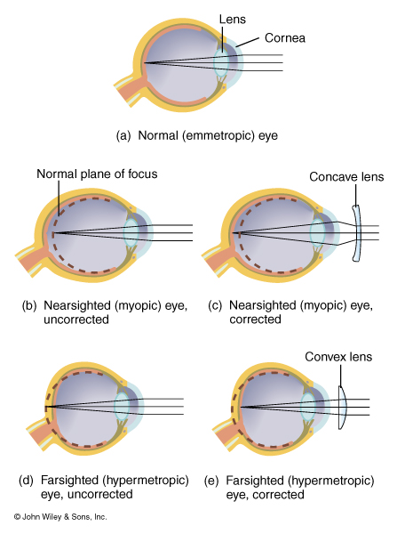
Abnormalities of
The Eye:
Myopic -
nearsighted
Hypermetropic -
Farsighted
Presbyopia -
age-related failure of
lens to accommodate
Astigmatism -
Distorted vision due to
irregular-shaped lens or
cornea
Color Blindness -
genetic defect that
causes dysfunction of
cones

Slide 17
Accommodation of the Lens for near vision
Ciliary muscles contract
Ciliary body pulls forward and inward
Tension on suspensory ligaments of lens is decreased
Lens becomes thicker (rounder) due to its elasticity
Pupils constricts

Slide 18
Accommodation of the Lens for far vision
Ciliary muscles relaxes
Ciliary body returns to its resting state, backward and outward
Tension on suspensory ligaments of lens is increased
Lens becomes thinner (flatter) due to its elasticity
Pupils dilate

Slide 19
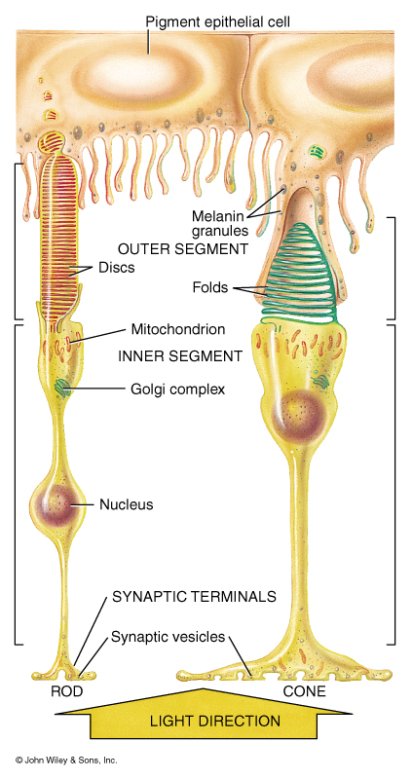
Anatomy of Rods and
Cones

Slide 20
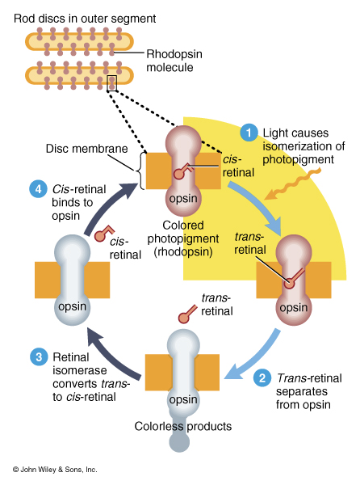
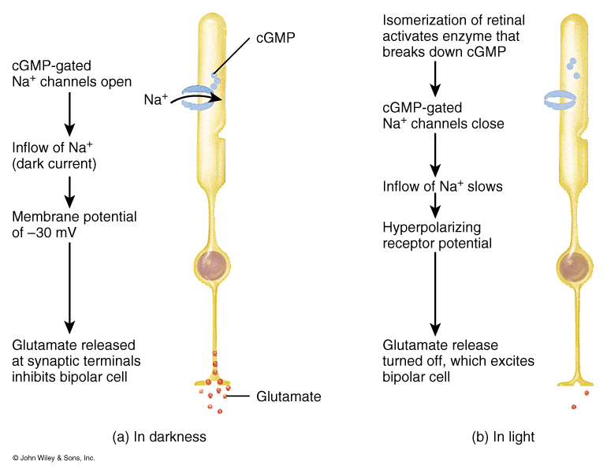
Physiology of Rods and Photopigments

Slide 21
Visual Pathway
Cones
Bipolar neurons
Ganglion cell’s axon forms the optic nerve
Optic nerve to the Optic Chiasm
Optic tract
Lateral geniculate nuclei of the thalamus
Optic Radiations
Primary visual areas of the occipital lobes

